Slide 1
Electrical Components
By SMC Engineering Club

Slide 2
Which components are most important?
Resistor
Capacitor
Diode
Inductor
Transistor
Microchip

Slide 3
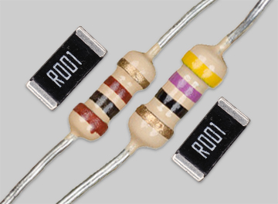
The Resistor
You’ve probably seen them before. They can look cylindrical with stripes of color and a wire coming out both ends (a carbon resistor), or as a small rectangular prism with a code on it (surface mount resistor). These are the two main types of resistors you’ll see and use. There are others, but you’ll most likely never use them. They all work about the same.

Slide 4
The Resistor
It opposes the flow of electrons to regulate voltage and current.
Wait… Voltage and Current?

Slide 5
Wait but what is Voltage and Current?
Quickly, Voltage and Current (also known as Amperage), are the two main ways to describe electricity. Voltage is the potential difference that drives an electrical charge while Current (Amperage) is the rate of flow of that charge. Think of it like a pipe. The Voltage is the pressure in the pipe, the Current (Amperage) is the size of the pipe, and the Resistance is how many grains of sand are in the pipe preventing the “fluid” from flowing. This is a simple way to explain it, but the size of the pipe has nothing to do with the size of the wire that the electrons flow through as you can have the same amperage and the same voltage flowing through many different gauges (thicknesses) of wire.

Slide 6
The Resistor
Back to resistors! As mentioned in the previous slide, they’re the “sand” in the “pipe.” Uses resistors can prevent too much voltage or current from reaching a component, like an LED which can be sensitive. The more electrons the resistor resists, the more heat is generated as the energy must go somewhere. Resistance is part of the Ohm’s law: I = V/R where I is the current, V is the voltage and R is the resistance. For example, if a 12 volt battery is connected to a 6 ohm resistor, then the current would be 2 amps.

Slide 7
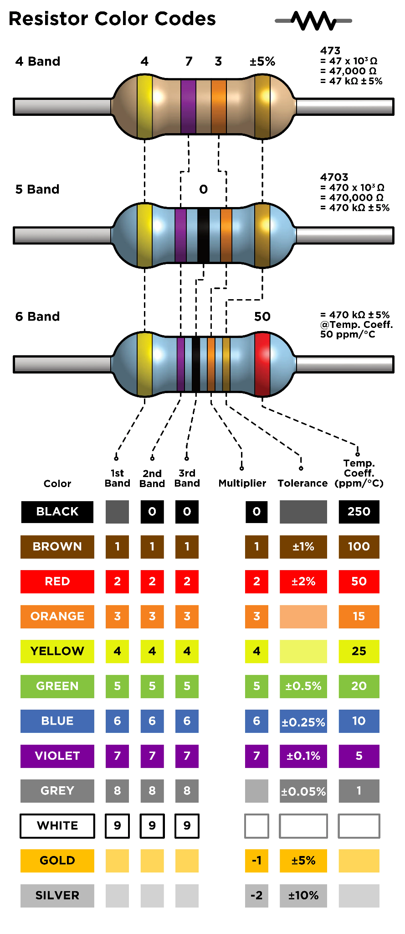
The Resistor
There are many, MANY, different resistances in both of the main form factors. Because of how many they are, the colorful stripes on the sides of a carbon resistor can give you a “code” to the resistance. There are different standards, but the photo to the right should cover most. Surface mount resistors usually have the resistance engraved onto it.

Slide 8
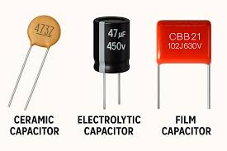
The Capacitor
Another component you’ve most likely seen before. They can look like a soda can with two wires popping out the bottom of it, or little circle alien looking thing. Another is a film capacitor, but you’ll most likely not see them too often.

Slide 9
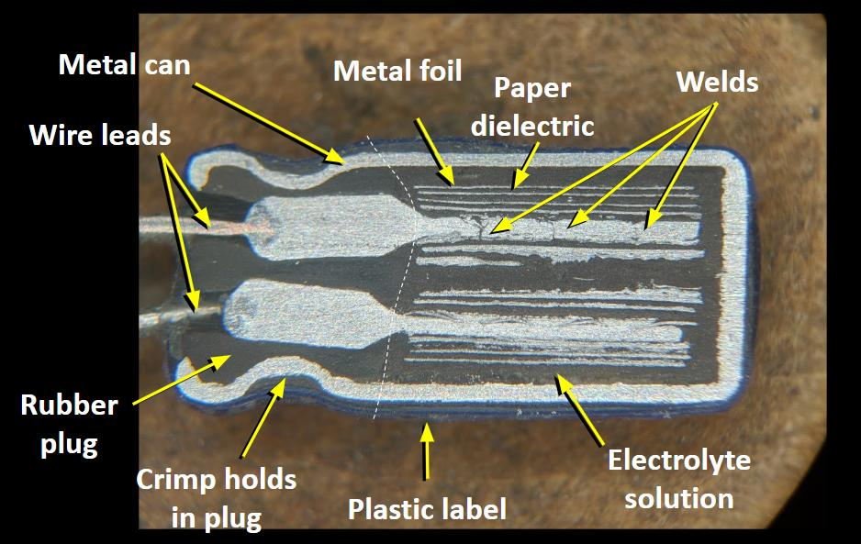
The Capacitor
A capacitor is a tiny rechargeable “bucket” for electric charge. It consists of two conductive plates and a thin insulator between them (called the dielectric). When you connect it to a power source, electrons will pile up on one place and are pulled from the other. That separation of charge stores energy in the electric field between the plates. Charge will flow for a moment until the capacitor’s voltage matches the source, then current will fade to almost zero. If you give the energy a path, it will push the current out briefly then fade as it empties.

Slide 10
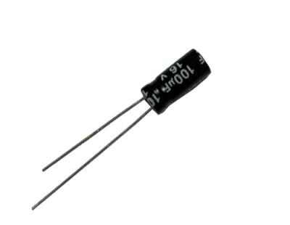
The Capacitor
The Capacitor has two legs and you need to remember one thing: The long leg is positive! They are not bi-directional and putting them backwards can cause them to fail spectacularly. Capacitors are also measured in something called a “Farad.” It is the unit of electrical capacitance. Though, most capacitors you will ever work with are measured in either nano, micro, or milli-farad. A picofarad sometimes, but never single farads. They are impractically large for most applications.

Slide 11
The Capacitor
Capacitors are usually used to smooth power (or decouple). They will usually sit next to chips to absorb little dips and spikes, keeping the voltage steady. Decoupling, using small ceramics (like 0.1µF) can help with fast and tiny transients. Or an bulk cap for slower, larger dips from bigger loads. For example, let’s say a servo starts moving. It may be rated for 500-800mA, but if it stalls, it could peak to above 1A (or even 2.2A for high-torque servos) reducing the voltage in the line. So, the capacitor helps to soften that peak by pushing out current to hold the voltage up, instead of the servo demanding it from the rest of your circuit. Anothing use is timing. Using a resistor and a capacitor together, they can charge and discharge at a predictable rate which can be used for delays, blinkers, beepers and clock shaping. Can also be used for quick energy bursts like the flash in a camera.

Slide 12
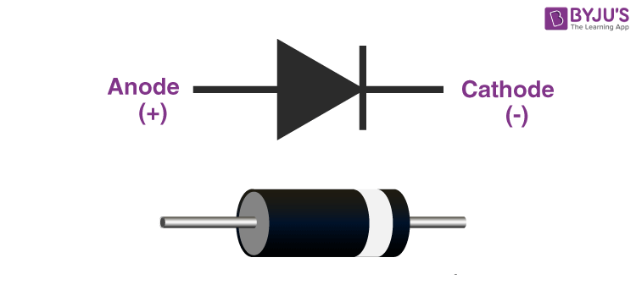
The Diode
A diode is simple. It’s pretty much a two-terminal semiconductor device that operates like a one-way valve for electrons. It has two electrodes, the anode and the cathode, and uses this for one-way flow direction. Obviously, this means that placing it in the wrong direction will cause it not to work as you wanted it to. They are usually simple cylinders with a marking to mark the cathode side. For smaller surface mount ones, they are small rectangular prisms similar to the surface mount resistors.

Slide 13
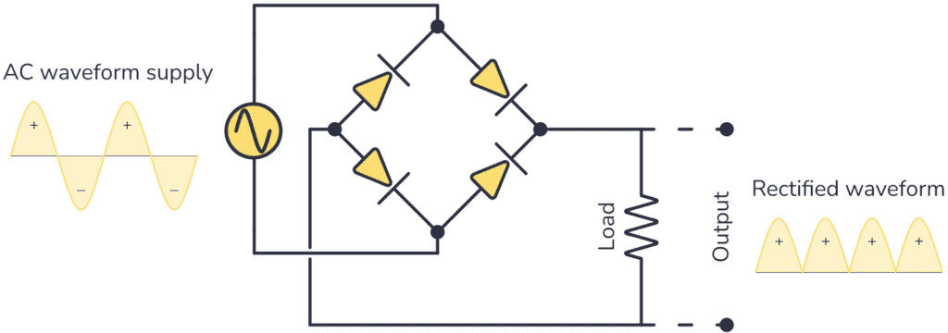
The Diode
Uses for a diode can be to simply project circuit from a reverse current. This can protect sensitive Integrated Circuits from a larger circuit. Another very well known use is a rectifier! This is a way to rectify alternating current (AC) into direct current (DC). This works by allowing the current to flow in one direction, thus blocking the reverse flow during half of the AC cycle. The AC cycle looks like a sine wave. What it does is it cuts off the bottom half of it.

Slide 14
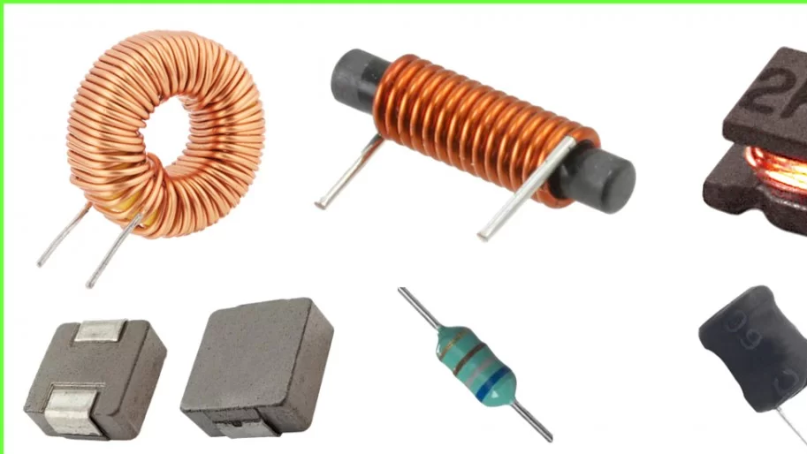
The Inductor
An inductor is a passive electronic component that stores energy in a magnetic field in a coil of wire. If you didn’t catch it and you’re wondering the difference between a capacitor and an inductor, the capacitor stores energy in an electric field while the inductor stores electricity in a magnetic field. This means that the capacitor resists changes in voltage while an inductor resists changes in current. So an inductor will develop a voltage to oppose a jump in current.

Slide 15
The Inductor
Inductors are used in filtering power to help smooth out ripple and high-frequency noise. You’ll find them on DC adapters. They can also be used in inductive proximity sensors, metal detectors, RFID, and even wireless charging like in your phone. Inductors aren’t always a fix though. They can cause a bit of kickback. Any coil (relay, solenoid, motor) will generate a high-voltage spike when current is suddenly interrupted. You’d need to use something like a flyback diode to help tame that.

Slide 16
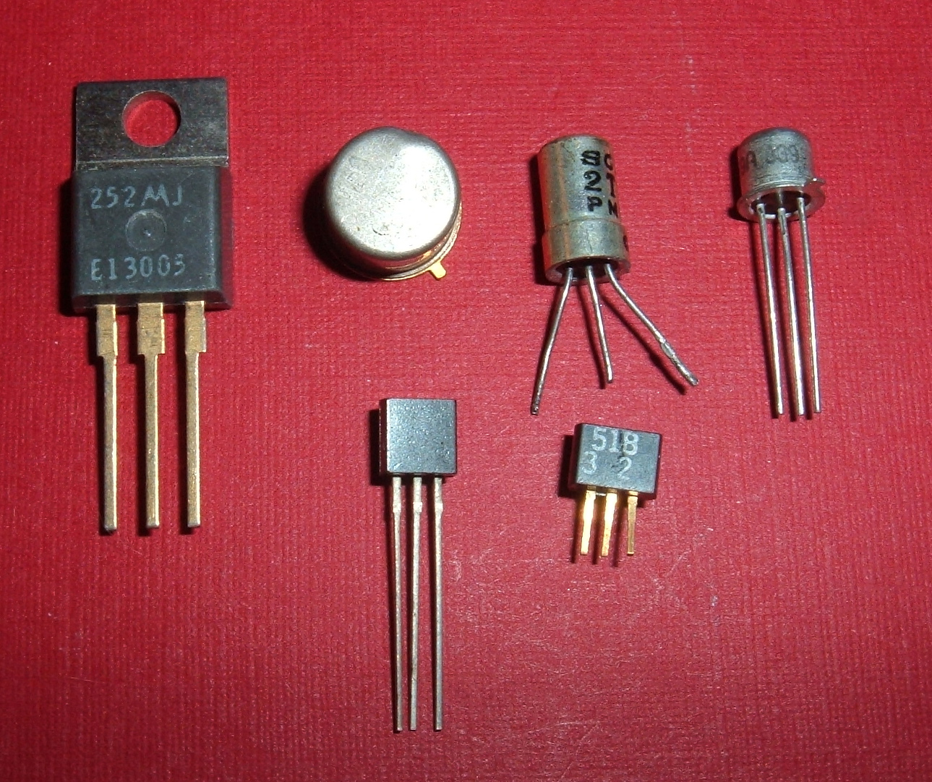
The Transistor
A transistor is a semiconductor that can amplify or switch electronic signals. It’s literally an electrical switch. You can find them in all sorts of shapes and sizes. Such as a bit larger for mosfets (which is an advanced transistor that is fast, highly efficient, and can be controlled with extremely little input current), or a bit smaller like the nanometer scale ones in your phone’s or computer’s integrated circles (like CPU or GPU).

Slide 17
The Transistor
As mentioned, a use is simply a switch. Turn an LED on and off electrically? A transistor is the way to go. Same with a relay, or solenoid, or even a DC motor. The transistor (depending specification) does a lot of the heavy lifting when it comes to big current. Another big use is amplification. It allows you to control a much higher current source with a very small control source, technically amplifying the initial control source. Another use is it’s the basis of many logic circuits. AND, OR, NOT, etc. Finally, the most important use in this day and age is… integrated circuits!

Slide 18
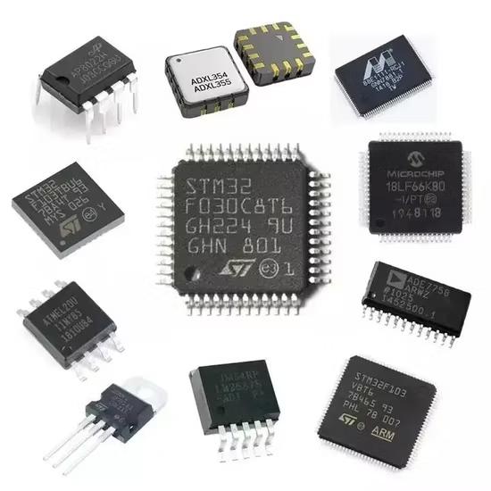
The Integrated Circuit
Integrated circuits, like a CPU, GPU, microprocessor and/or even small chips used for power delivery or simple data processing are very important. They’re designed made of mostly very very very small transistors in chains that process signals, digital, analog, or mixed-signal, efficiently. Your phone contains billions of transistors to do almost anything digitally. Simply, an Integrated Circuit (or IC) is a miniature electronic circuit that combines multiple electronic components into a single chip, usually made of silicon.

Slide 19
The Integrated Circuit
Integrated circuits are not only just your super-dense processor, but they’re used in many other locations on a board or in a charger. One use are voltage regulators to keep 5V / 3.3V steady, such as while using buck converters. They are also used in battery chargers to handle USB-C, power path, protections, and allow communication for USB power delivery. There are ICs for sensors across a wind range of applications like temperature, acceleration, pressure, light, magnetic, distance, etc. There are even filters to help clean up or digitize sound and op-amps to amplify small signals (using transistors). There are also ones that process radio data like Wi-Fi, bluetooth, NFC/RFID, etc.

Slide 20
Conclusion
As you can see, even the most basic components (especially the first 5) can be used to process any sort of data, power just about anything, and do just about anything you want. It’s just about how you put it together. There’s a whole world of electronics to explore and create! Take the first step with us this semester.

